Slide 1
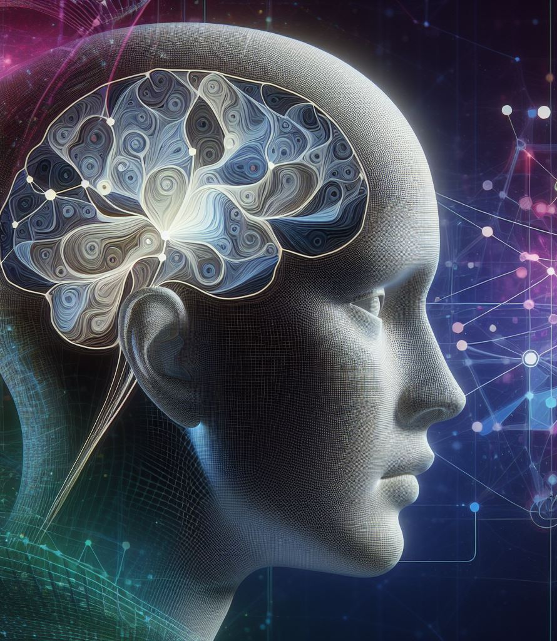
Generative Models
Notes:
Image made by DALL-E 3

Slide 2
Generative Models
Variational Autoencoders
Generative Adversarial Networks (GANs)
Deep Convolutional GAN (DCGAN)
Wasserstein GAN with Gradient Penalty (WGAN-GP)
Conditional GAN (CGAN)

Slide 3

Variational Autoencoders

Slide 4
Variational Autoencoder
Let’s try to generate people’s clothes
We need two components: the encoder and the decoder
The encoder “moves” each item of clothing to a location in a space that we call “wardrobe”
This process is called encoding
The decoder “selects” a location in the wardrobe and attempts to re-create the item
This process is called decoding
Notes:
In 2013, Diederik P. Kingma and Max Welling introduced the variational autoencoder (VAE)

Slide 5
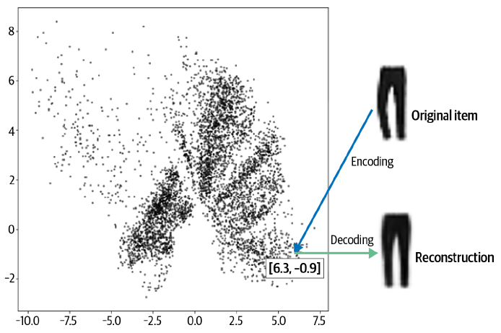
Variational Autoencoder
Each location item location is represented by two coordinates
For example, the trousers are encoded to the point [6.3, –0.9]
This vector 2 values (2D vector) is also known as an embedding
The encoder compresses information, enabling the decoder to reconstruct accurately
An autoencoder is a neural network that encodes and decodes items
It can generate new clothing designs from any 2D point
Notes:
In 2013, Diederik P. Kingma and Max Welling introduced the variational autoencoder (VAE)

Slide 6
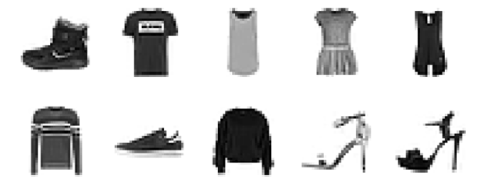
The Fashion-MNIST Dataset
The Fashion-MNIST dataset is a collection of grayscale images of clothing items, each of size 28 × 28 pixels

Slide 7
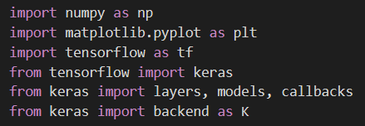
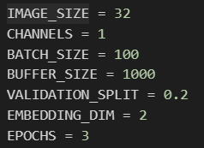
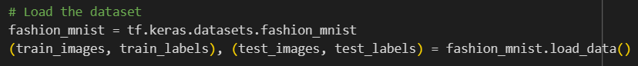
The Fashion-MNIST Dataset
Let’s start with this:

Slide 8
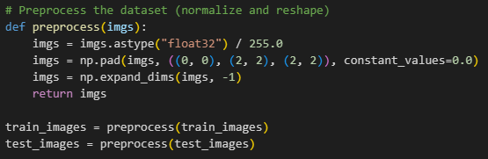
The Fashion-MNIST Dataset
Pixel values are between 0 and 255, we need to scale them between 0 and 1 (same as we did for MNIST)
But now we also pad each image to 32 × 32
This will ease the manipulation of the tensor shape as it passes through the network
Notes:
Np.pad will add 2 lines of 0s up and down, left and right, but will not add any channel
Np.expand_dims will add a dimension for the last element (-1 in python indexing) [we make a tensor]

Slide 9
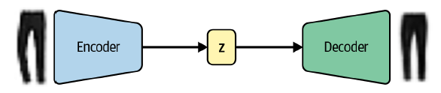
The Autoencoder Architecture
An autoencoder is a neural network with two components:
An encoder network that compresses high-dimensional input data into a lower-dimensional embedding vector
A decoder network that decompresses a given embedding vector back to the original domain
Here, input is encoded to a latent embedding vector z, which is then decoded back to the original pixel space

Slide 10
The Autoencoder Architecture
Sampling from the embedding space (also called the latent space) allows to generate new images
An embedding (z) compresses the original image into a lower-dimensional latent space
Choosing a point in the latent space allows generating novel images via the decoder
Autoencoder’s latent space has usually more than 2 dimensions for capturing image nuance

Slide 11
Autoencoders as Denoising Models
Autoencoders clean noisy images by ignoring random noise positions in the latent space.
Our 2D latent space lacks sufficient information for this task
However, increasing latent space dimensions too much can cause generative model issues!

Slide 12
The Encoder
In an autoencoder, the encoder takes the input image and map it to an embedding vector in the latent space
To achieve this, we first create an Input layer for the image and pass this through three Conv2D layers in sequence
Each layer captures increasingly high-level features
We use a stride of 2 to halve the size of the output of each layer
This will also increase the number of channels
The last convolutional layer is flattened and connected to a Dense layer of size 2
This layer represents our 2-dimensional latent space

Slide 13
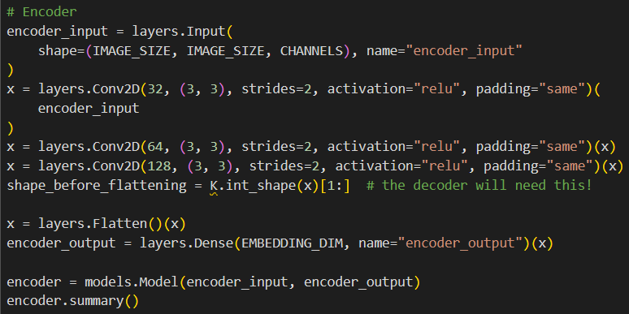
The Encoder
Input layer
Convolutional layers (3)
Flattening
Connect the flatten vector to the 2D embeddings with a Dense layer
Keras model that defines the encoder
Notes:
We’ll use shape_before_flattening later
Layers.Dense(Emb…) tells us how big the output is (in our case is 2)

Slide 14
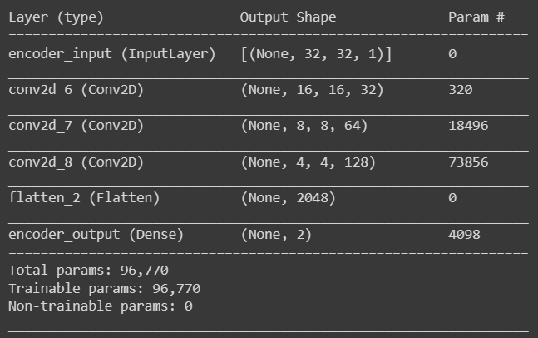
The Encoder

Slide 15
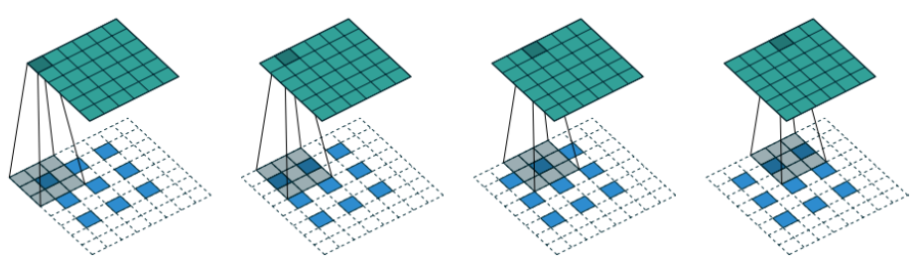
The Decoder
The decoder is a mirror image of the encoder, but instead of convolutional layers, we use Convolutional Transpose layers
Standard convolutional layers halve input tensor size by setting strides = 2
Convolutional transpose layer doubles input tensor size with strides = 2
Conv2DTranspose gradually expands layers to original 32 × 32 image dimension

Slide 16
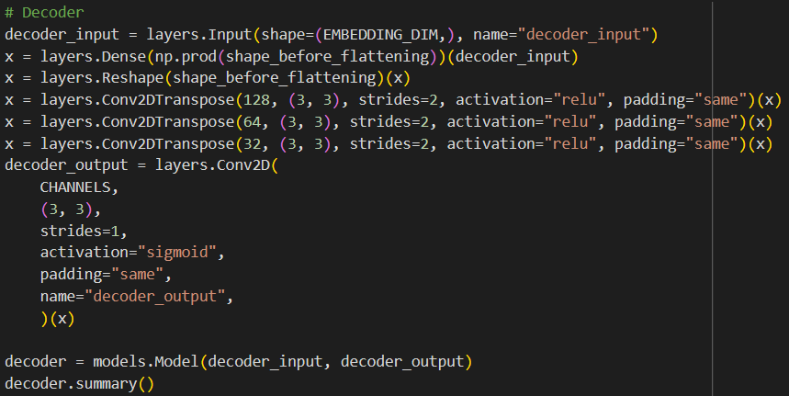
The Decoder
Connect input to Dense layer
Input layer
Reshape this vector into a tensor that we can fed into the Conv2DTranspose layer
Convolutional Transpose layers (3)
Keras model that defines the decoder
Notes:
We’ll use decoder_output later
numpy.prod() returns the product of array elements over a given axis. We want to have the same number of inputs as outputs of the previous step. [for us is 2 in input, and a lot in output]
Layers.Reshape will reshape the inputs to the given parameter value [input of what comes next, Conv2DT]

Slide 17
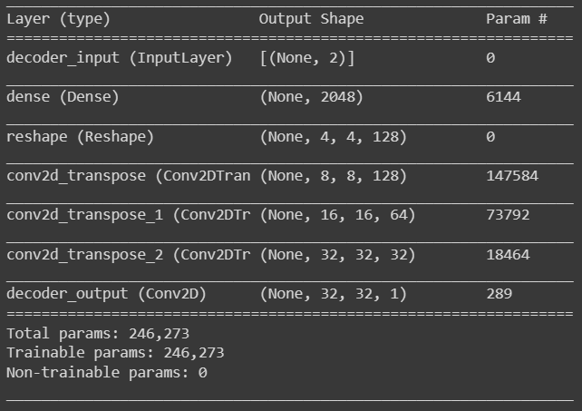
The Decoder

Slide 18
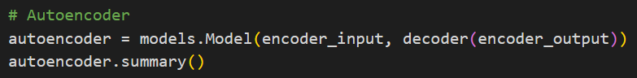
Joining the Encoder to the Decoder
To train the encoder and decoder simultaneously, we define a model representing the image flow through the encoder and back out through the decoder
Note that the output from the autoencoder is simply the output from the encoder after it has been passed through the decoder

Slide 19
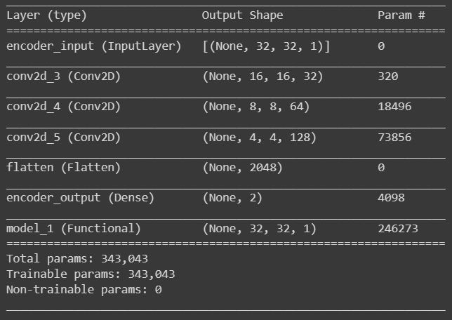
Joining the Encoder to the Decoder

Slide 20
Joining the Encoder to the Decoder
Now we need to compile it with a loss function and optimizer
The loss function is usually root mean squared error (RMSE) (aka L2 loss) or binary cross-entropy
Notes:
binary cross-entropy would be between the individual pixels of the original image and the reconstruction

Slide 21
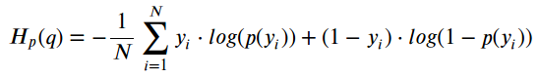
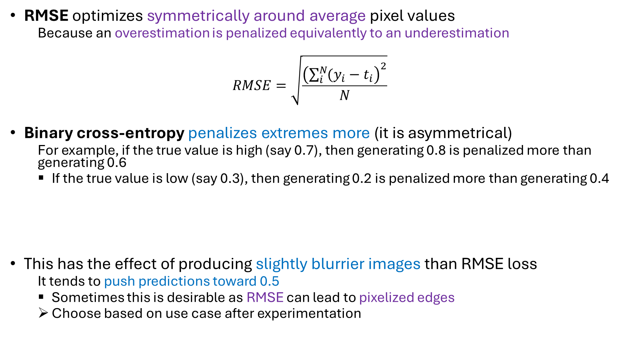
Choosing the Loss Function
RMSE optimizes symmetrically around average pixel values
Because an overestimation is penalized equivalently to an underestimation
$$RMSE=\sqrt{\frac{{\left(\sum_{i}^{N}{(y_{i}−t_{i}}\right)}^{2}}{N}}$$
Binary cross-entropy penalizes extremes more (it is asymmetrical)
For example, if the true value is high (say 0.7), then generating 0.8 is penalized more than generating 0.6
If the true value is low (say 0.3), then generating 0.2 is penalized more than generating 0.4
This has the effect of producing slightly blurrier images than RMSE loss
It tends to push predictions toward 0.5
Sometimes this is desirable as RMSE can lead to pixelized edges
Choose based on use case after experimentation
Notes:
The loss is between the image it should be and what the model outputs
Note that binary_cross_entropy can be used only if the values are scaled between 0 and 1

Slide 22
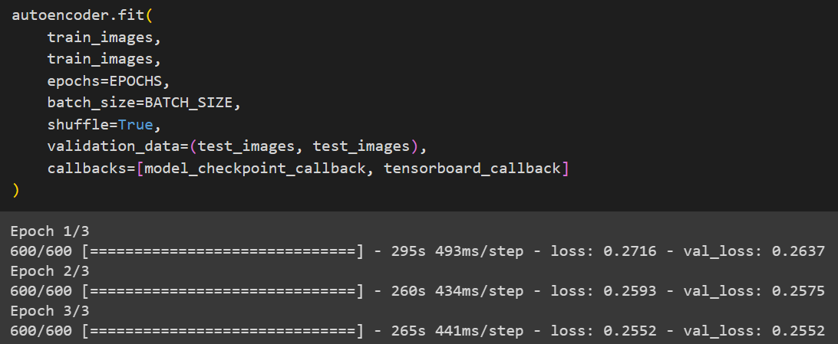
Training the Autoencoder
Notes:
This may take some time

Slide 23
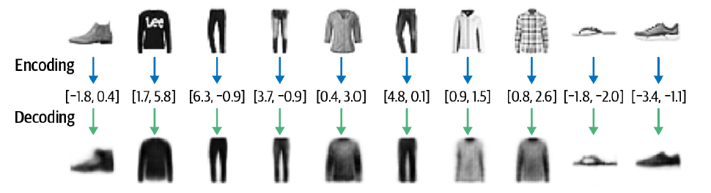
Reconstructing Images
We can test the ability to reconstruct images by passing images from the test set through the autoencoder and comparing the output to the original images

Slide 24
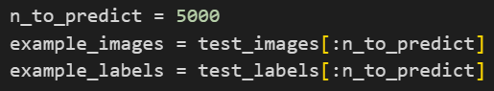
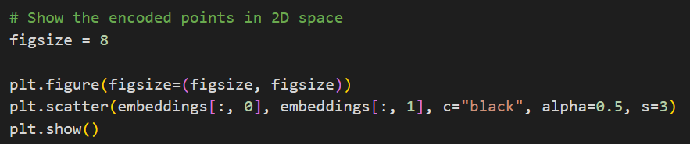
Visualizing the Latent Space
We can visualize how images are embedded into the latent space by passing the test set through the encoder and plotting the resulting embeddings

Slide 25
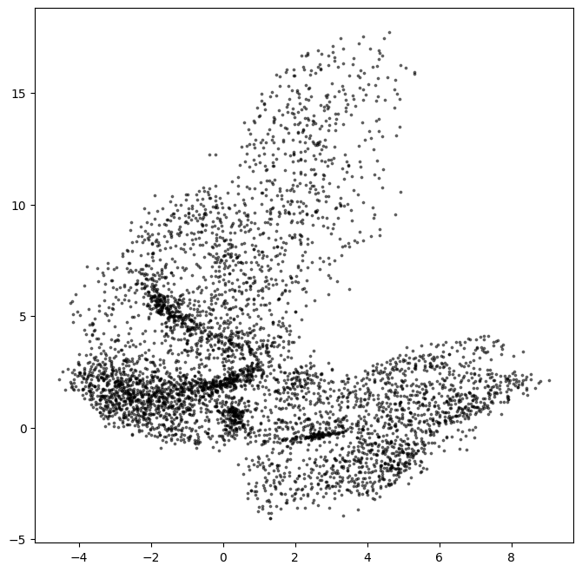
Each black point represents an image embedded into the latent space

Slide 26
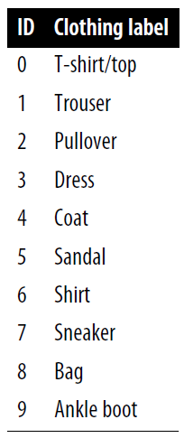
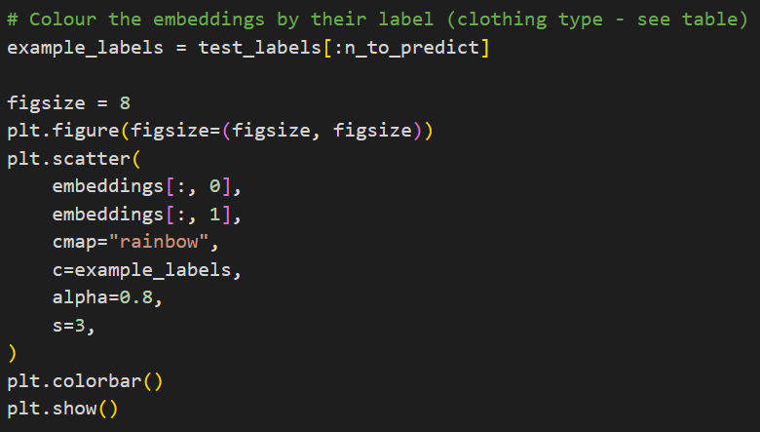
Visualizing the Latent Space
Let’s use the labels to understand this latent space better
We can color each point based on the label of the corresponding image

Slide 27
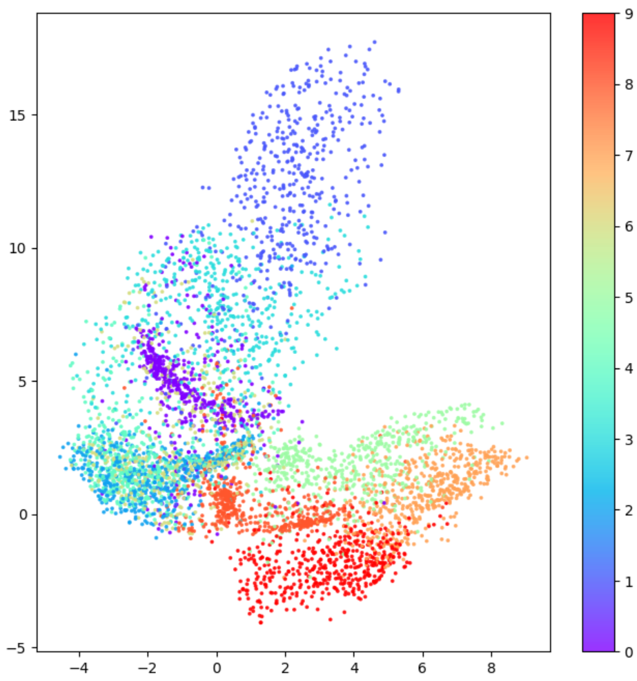
The autoencoder has grouped items that look alike into the same parts of the latent space

Slide 28
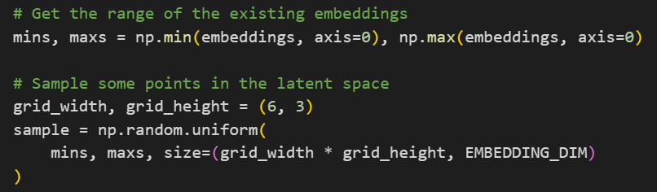
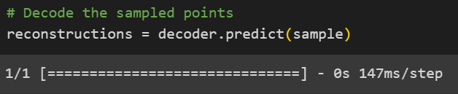
Generating New Images
We can generate images by sampling points in the latent space
We then use the decoder to convert these back into pixel space
Notes:
The “size” parameters tells us how many random points will be generated (here is an array of shape [(gridW*gridH), (EmbDim)], so (18, 2)

Slide 29
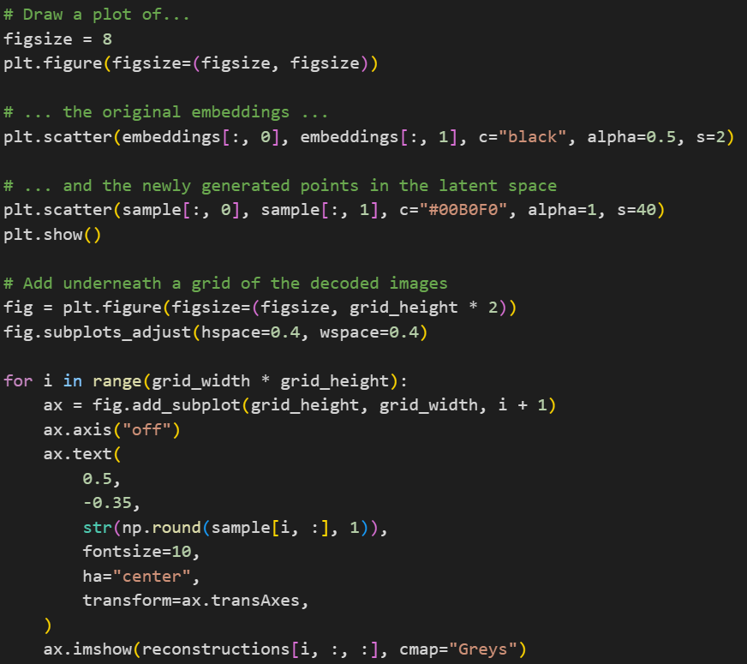

Slide 30
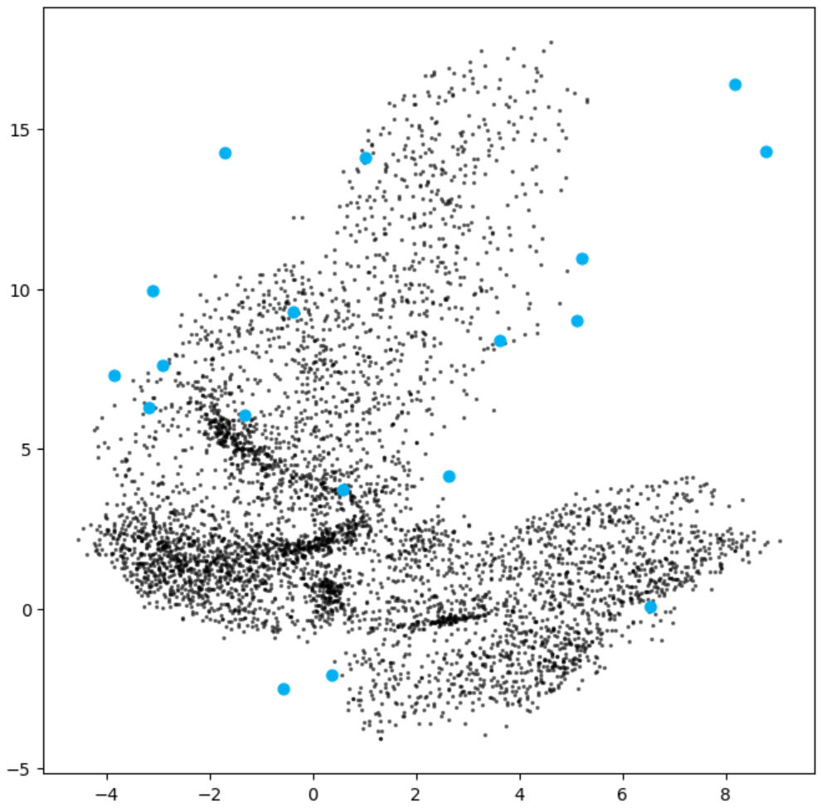
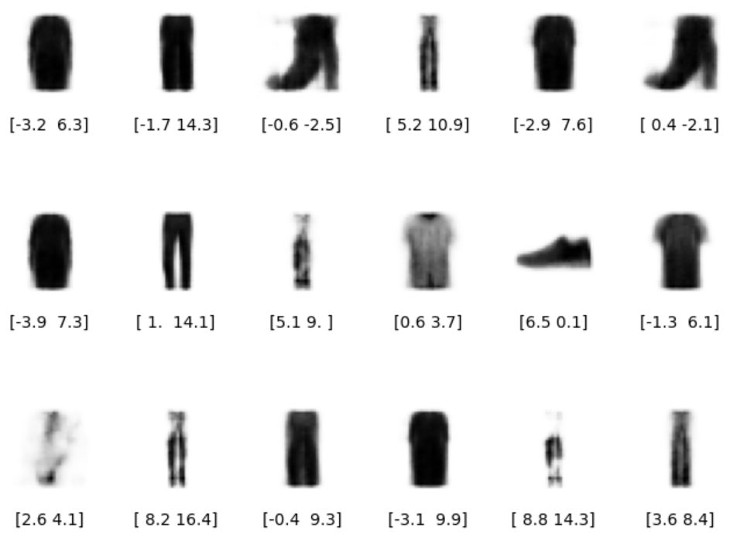
Some of the generated images are more realistic than others… Why is this?

Slide 31
Some images are represented over a very small area
Others over a much larger area
The distribution is not symmetrical around (0, 0), or bounded
More points with positive y-axis values than negative, and some points even extend to a y-axis value > 8.
There are large gaps between colors containing few points

Slide 32
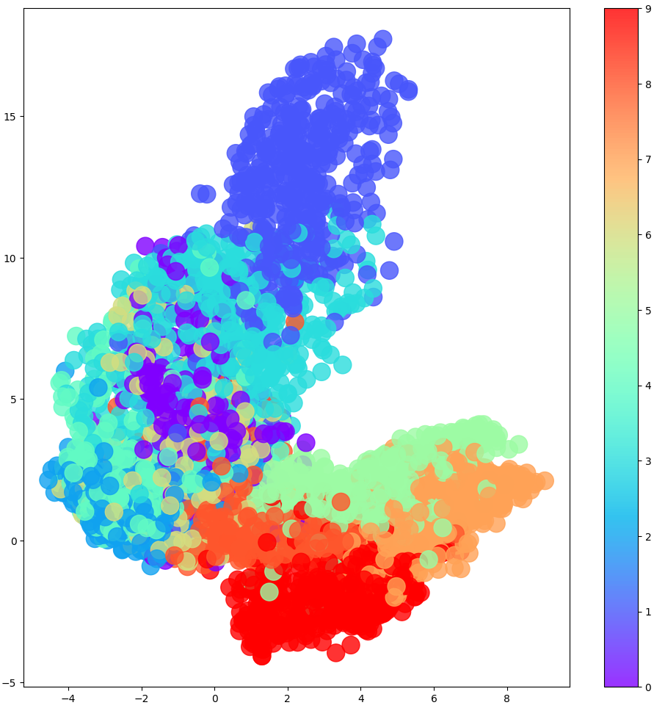
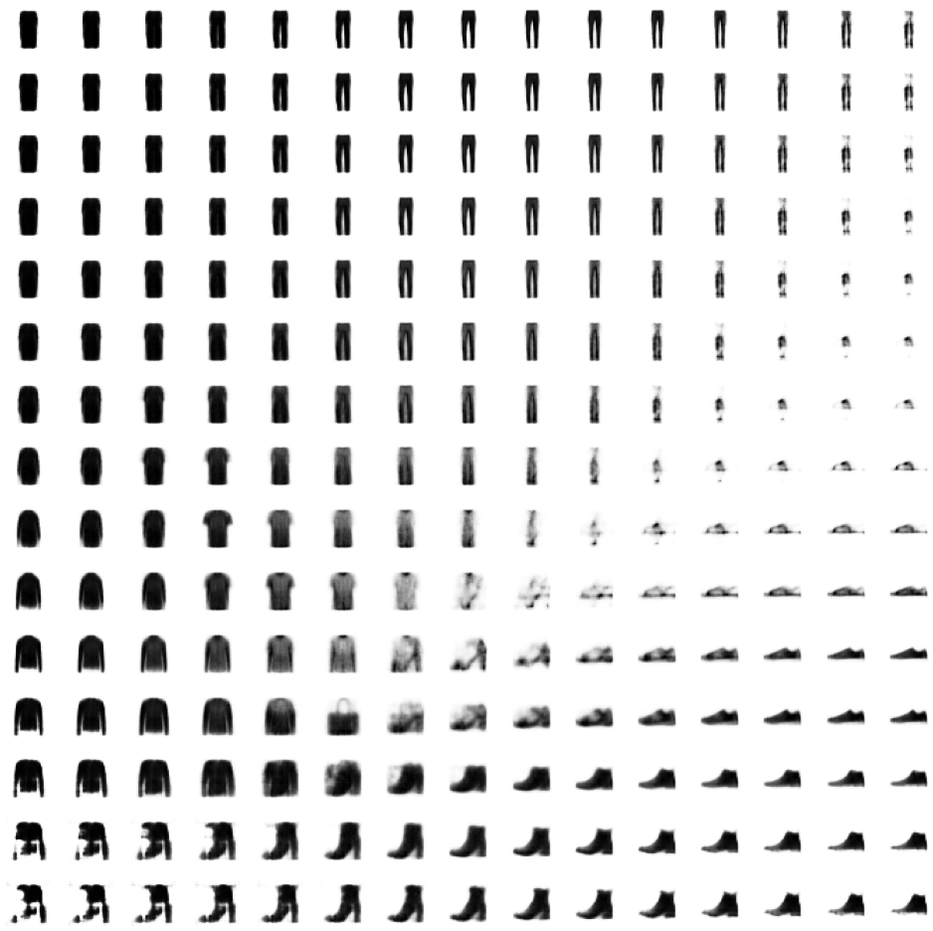
If we overlay the latent space with images of decoded points on a grid, we see why the decoder may not always generate good images

Slide 33
If we overlay the latent space with images of decoded points on a grid, we see why the decoder may not always generate good images

Slide 34
If we overlay the latent space with images of decoded points on a grid, we see why the decoder may not always generate good images

Slide 35
Generating New Images
If we pick points uniformly, we’re more likely to sample a specific item instead of others
Because there are more of that item in that area
It is not obvious how to select a random point in the latent space
Since the distribution of these points is undefined
We can see holes in the latent space where none of the original images are encoded

Slide 36
Generating New Images
There are large white spaces at the edges of the domain
The autoencoder has no reason to decode recognizable items
Because very few images in the training set are encoded here
Even points that are central may not be decoded correctly
This is because the autoencoder doesn’t ensure that the space is continuous
For example, even though the point (–1, –1) might be decoded to a good image, there is nothing ensure that the point (–1.1, –1.1) also produces a satisfactory image

Slide 37
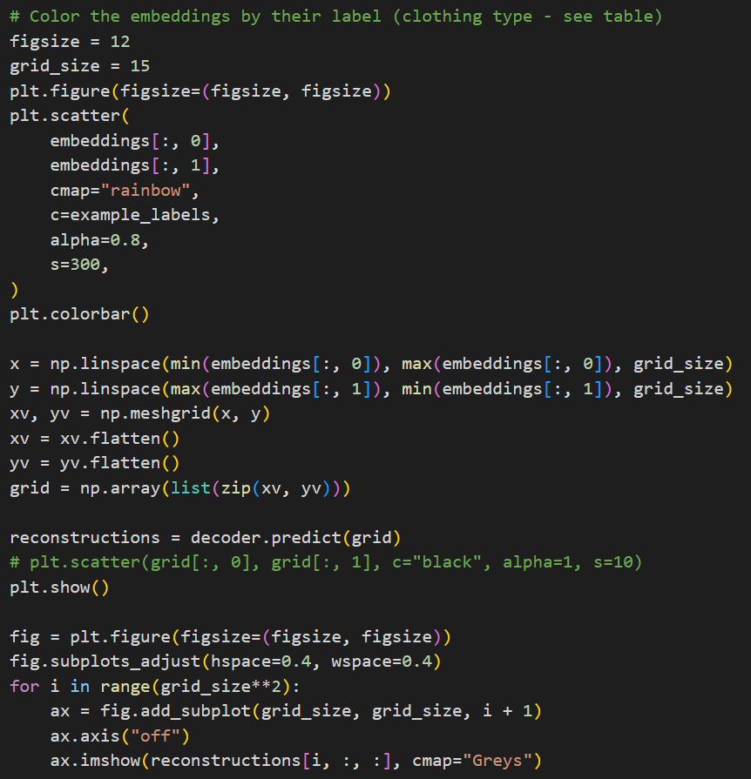
Notes:
Code to generate the previous images

Slide 38
Generating New Images
In 2D, this issue is not so big
The model has to squash clothing groups together, resulting in the space between clothing groups being relatively small
However, with more dimensions in the latent space this issue becomes even more apparent
More dimensions are useful to generate complex images, such as faces
In order to solve the three problems, we need to convert our autoencoder into a variational autoencoder
Notes:
notebooks/03_vae/01_autoencoder/autoencoder.ipynb

Slide 39
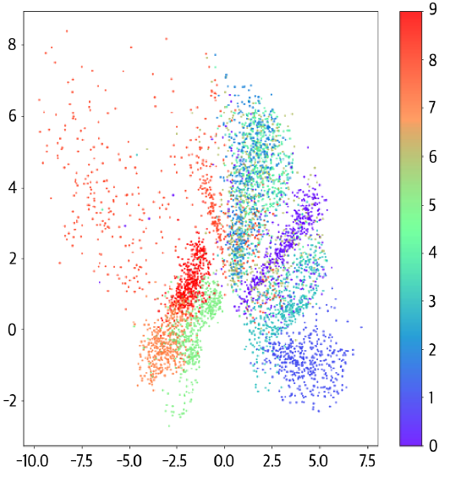
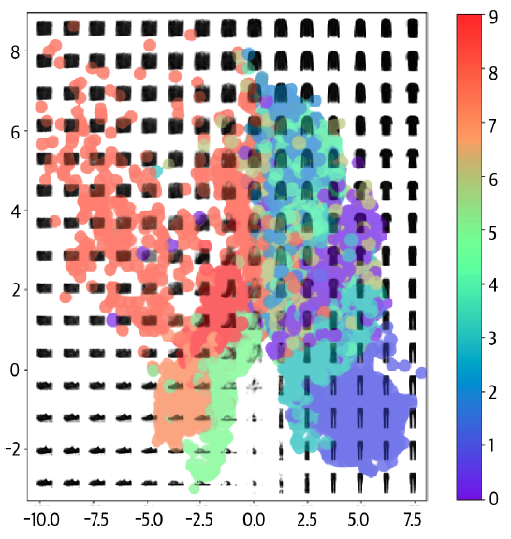
Notes:
Another example

Slide 40
Variational Autoencoders
Variational autoencoders solve those problems by introducing randomness into the model and constraining how points are distributed in the latent space
We will add some constrains to the Encoder
The center of each item’s area need to be as closer to the middle (0, 0) as possible
The deviation of the item from the center should be as close to one unit as possible
The further the Encoder strays from these constraints, the higher the loss
How do we implement this?

Slide 41
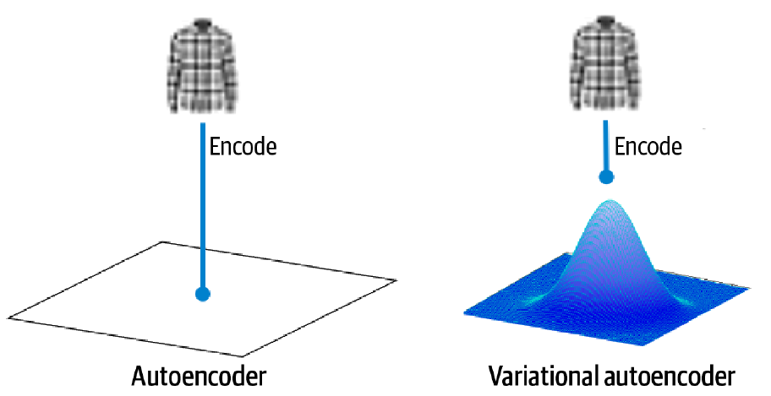
Updated Encoder
In an autoencoder, each image is mapped directly to one point in the latent space
In a variational autoencoder, each image is mapped to a multivariate normal distribution around a point in the latent space

Slide 42
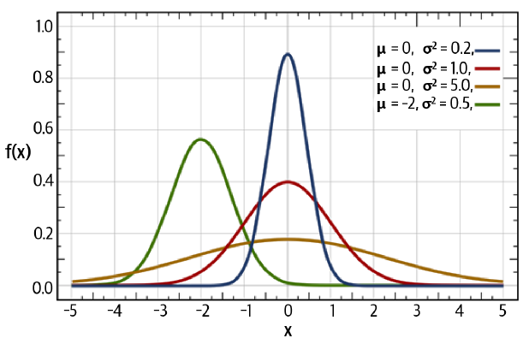
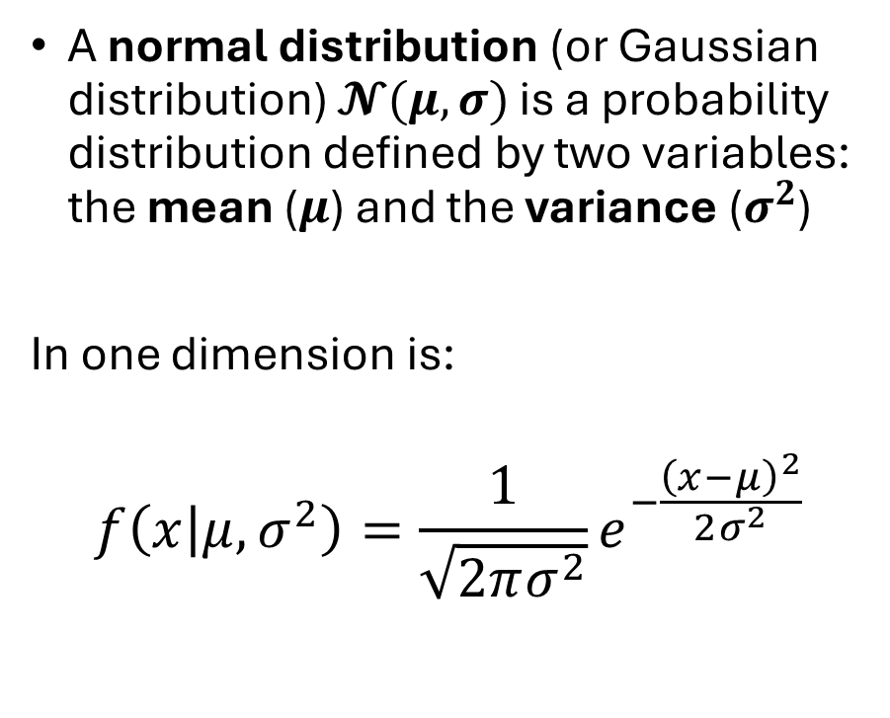
The Multivariate Normal Distribution
A normal distribution (or Gaussian distribution) $𝓝(μ,σ)$ is a probability distribution defined by two variables: the mean ($μ$) and the variance ($σ^{2}$)
In one dimension is:
$$f\left(x | μ,σ^{2}\right)=\frac{1}{\sqrt{2πσ^{2}}}e^{−\frac{{\left(x−μ\right)}^{2}}{2σ^{2}}}$$
The red curve is the standard normal (or unit normal) $𝒩(0,1)$

Slide 43
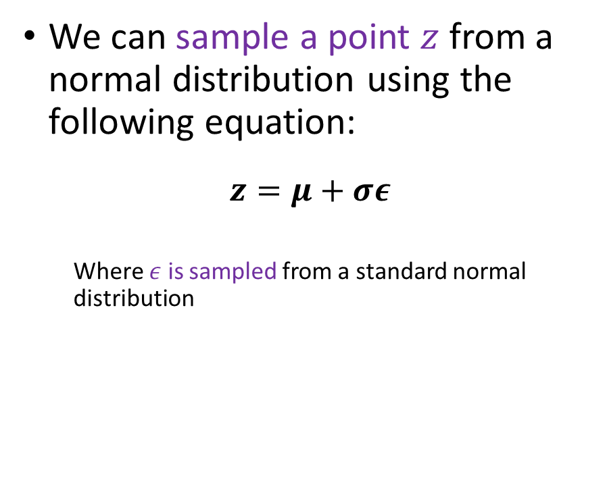
The Multivariate Normal Distribution
We can sample a point $z$ from a normal distribution using the following equation:
$$z=μ+σε$$
Where $ε$ is sampled from a standard normal distribution
The red curve is the standard normal (or unit normal) $𝒩(0,1)$

Slide 44
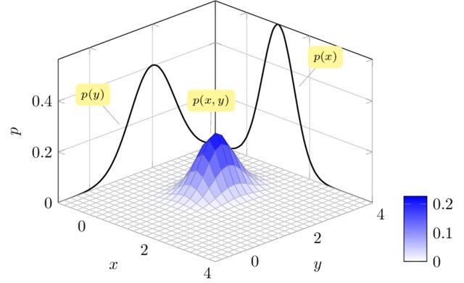
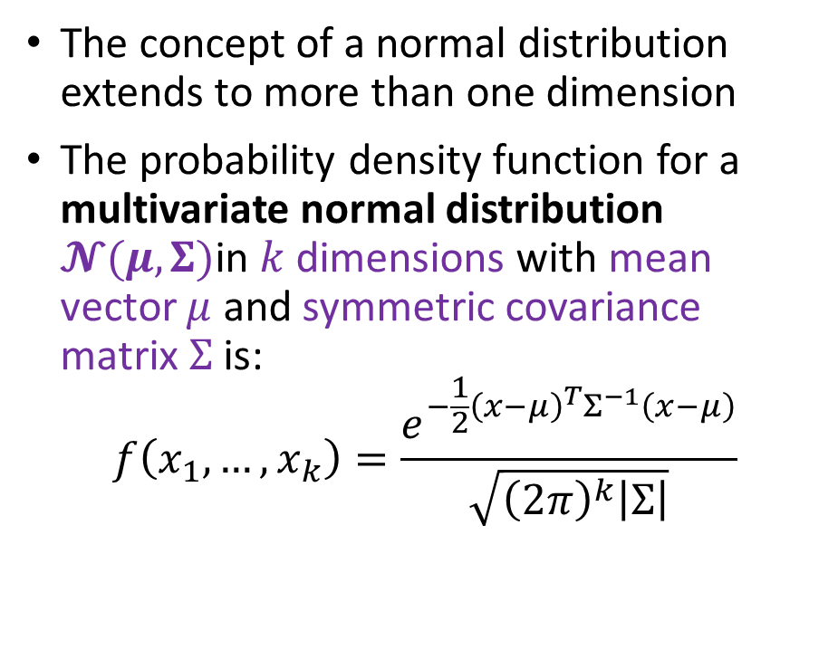
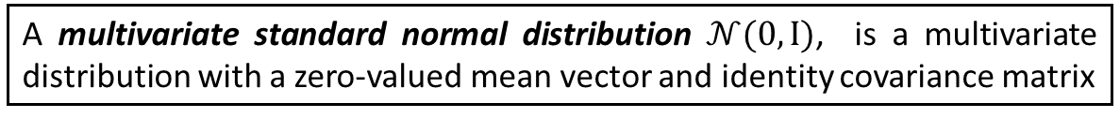
The Multivariate Normal Distribution
The concept of a normal distribution extends to more than one dimension
The probability density function for a multivariate normal distribution $𝓝(μ,Σ)$in $k$ dimensions with mean vector $μ$ and symmetric covariance matrix $Σ$ is:
$$f\left(x_{1},…,x_{k}\right)=\frac{e^{−\frac{1}{2}{\left(x−μ\right)}^{T}Σ^{−1}\left(x−μ\right)}}{\sqrt{{\left(2π\right)}^{k}\left|Σ\right|}}$$
A multivariate standard normal distribution $𝒩(0,I)$, is a multivariate distribution with a zero-valued mean vector and identity covariance matrix
Notes:
To be precise, we will use an isotropic multivariate normal distribution, where the covariance matrix is diagonal.
This means that the distribution is independent in each dimension (i.e., we can sample a vector where each element is normally distributed with independent mean and variance)
Image is from “(PDF) Bayesian tracking of multiple point targets using Expectation Maximization (researchgate.net)”

Slide 45
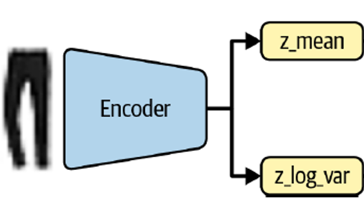
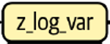
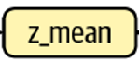
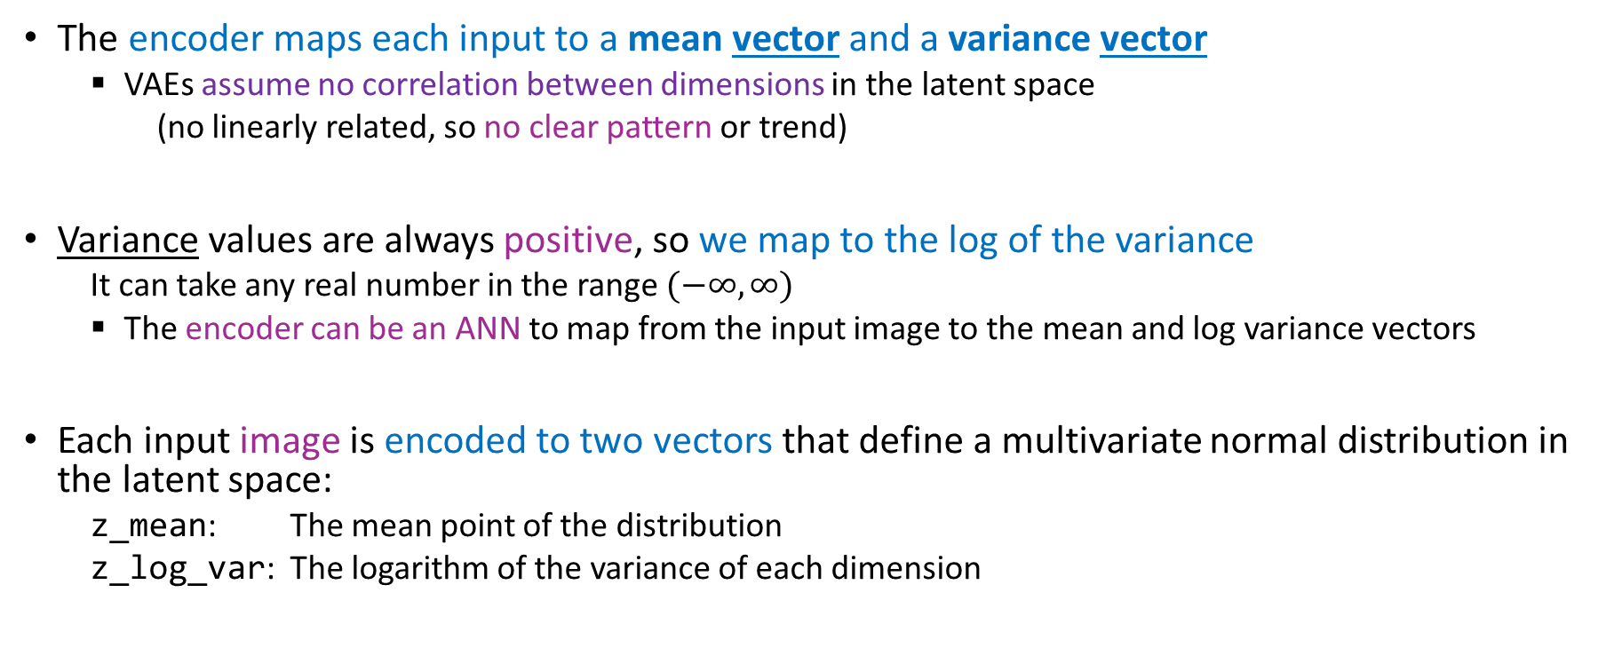
Updated Encoder
The encoder maps each input to a mean vector and a variance vector
VAEs assume no correlation between dimensions in the latent space
(no linearly related, so no clear pattern or trend)
Variance values are always positive, so we map to the log of the variance
It can take any real number in the range $(−∞, ∞)$
The encoder can be an ANN to map from the input image to the mean and log variance vectors
Each input image is encoded to two vectors that define a multivariate normal distribution in the latent space:
z_mean: The mean point of the distribution
z_log_var: The logarithm of the variance of each dimension

Slide 46
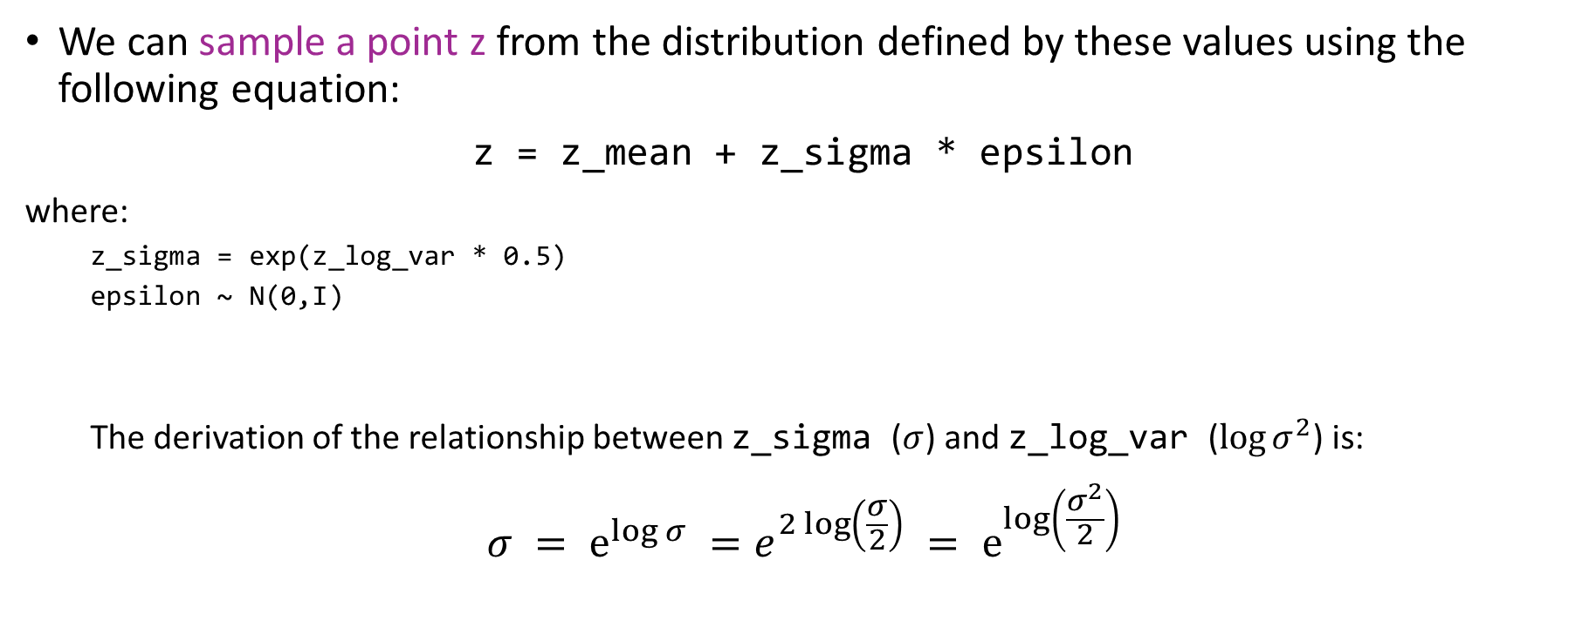
Updated Decoder
We can sample a point z from the distribution defined by these values using the following equation:
z = z_mean + z_sigma * epsilon
where:
z_sigma = exp(z_log_var * 0.5)
epsilon ~ N(0,I)
The derivation of the relationship between z_sigma ($σ$) and z_log_var ($log⁡σ^{2}$) is:
$$σ = e^{\log{σ}} =e^{2\log\left(\frac{σ}{2}\right)} = e^{log\left(\frac{σ^{2}}{2}\right)}$$

Slide 47
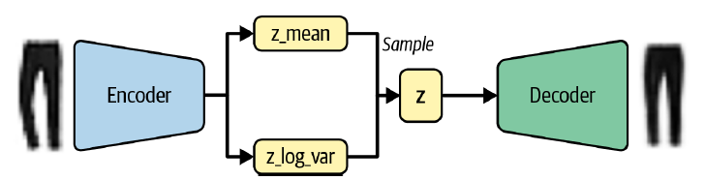
Updated Decoder
Why does this small change to the encoder help?
We are now sampling a random point from an area around z_mean
The decoder must ensure that all points around produce similar images when decoded
In this way, the reconstruction loss remains small

Slide 48
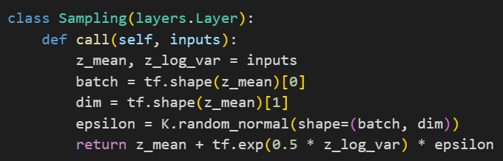
Building the VAE encoder
First, we need to create a new type of Sampling layer that will allow us to sample from the distribution defined by z_mean and z_log_var
We create a new layer by subclassing the Layer class
We use the reparameterization trick to build a sample from the normal distribution parameterized by z_mean and z_log_var
Notes:
You can create new layers in Keras by subclassing the abstract Layer class and defining
the call method, which describes how a tensor is transformed by the layer.
For example, in the variational autoencoder, we can create a Sampling layer that can
handle the sampling of z from a normal distribution with parameters defined by
z_mean and z_log_var

Slide 49
The Reparameterization Trick
Rather than sample directly from a normal distribution with parameters z_mean and z_log_var:
We sample epsilon from a standard normal
We manually adjust the sample to have the correct mean and variance
Now gradients can backpropagate freely through the layer
The randomness of the layer is contained within the variable epsilon, so the partial derivative is deterministic (independent of the random epsilon)
This is essential for backpropagation through the layer
epsilon is treated as noise
Notes:
Precisely: The partial derivative of the layer output with respect to its input

Slide 50
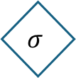







Original
Reparameterised form
Backprop
f
f
Backprop
$$\frac{∂f}{∂z}$$
z
$$\frac{∂f}{∂z}$$
z
$$μ$$
$$σ$$
$$\frac{∂f}{∂μ}≅\frac{∂L}{∂μ}$$
$$μ$$
$$σ$$
$$ε$$
Random node
Backpropagation does not go through randomness anymore

Slide 51

The Flatten layer is connected to layers z_mean and z_log_var (instead of the 2D latent space)
The Sampling layer samples a point z in the latent space from the normal distribution defined by the parameters z_mean and z_log_var
The Keras Model that defines the encoder
It takes an input image and outputs z_mean, z_log_var, and a sampled point z from the normal distribution defined by these parameters

Slide 52

Building the VAE encoder

Slide 53
Kullback–Leibler divergence
We need to change the loss function
Previously, the loss function consisted of the reconstruction loss between images and their attempted copies
The reconstruction loss in a VAE requires the Kullback–Leibler (KL) divergence term
KL divergence is a way of measuring how much one probability distribution differs from another

Slide 54


Kullback–Leibler divergence term
In a VAE, we want to measure how much our normal distribution with parameters z_mean and z_log_var differs from a standard normal distribution
In this special case, KL divergence has the following closed form:
$$\text{kl}\text{_}\text{loss}\text{ = −0.5 ∗ }\text{sum}\text{(1 + }\text{z}\text{_}\text{log}\text{_}\text{var}\text{ − }\text{z}\text{_}\text{mean}\text{ ^ 2 − }\text{exp}\text{(}\text{z}\text{_}\text{log}\text{_}\text{var}\text{))}$$
or in mathematical notation:
$D_{KL}[𝒩(μ,σ$ || $𝒩(0,1)]=−\frac{1}{2} \sum{\left(1+\log\left(σ^{2}\right)−μ^{2}−σ^{2}\right)}$
$\text{kl}\text{_}\text{loss}$is minimized to 0 when $\text{z}\text{_}\text{mean}= 0$and $\text{z}\text{_}\text{log}\text{_}\text{var}=0$ for all dimensions
As these two terms start to differ from 0, $\text{kl}\text{_}\text{loss}$ increases
Notes:
The sum is taken over all the dimensions in the latent space.
In summary, the KL divergence term penalizes the network for encoding observations to$\text{z}\text{_}\text{mean}$ and $\text{z}\text{_}\text{log}\text{_}\text{var}$ variables that differ significantly from the parameters of a standard normal distribution, $\text{z}\text{_}\text{mean}= 0$and $\text{z}\text{_}\text{log}\text{_}\text{var}=0$
Also, the “||” represents the divergence

Slide 55

Building the VAE encoder
$$Loss_{new} = Reconstruction_{loss} + KL_{loss}$$
Why does this addition to the loss function help?
We now have a standard normal distribution for sampling points in the latent space
Since all encoded distributions are enforced toward the standard normal distribution, large gaps between points are less likely
The encoder will try to use the space around the origin symmetrically and efficiently

Slide 56

Building the VAE encoder
$$Loss_{new} = Reconstruction_{loss} +β KL_{loss}$$
The $β$-VAE includes a factor that weights the KL divergence
If $β$ is too small, the KL loss will not have the regulatory effect
We will see the same problems that we experienced with the plain autoencoder
If $β$ is too large, the reconstructed images will be poor
This weighting term is one of the parameters to tune when you’re training your VAE

Slide 57
A B C

Slide 58
Training the Variational Autoencoder
We’ll see how to build the overall VAE model as a subclass of the abstract Keras Model class
This allows us to include the calculation of the KL divergence term of the loss function in a custom train_step method

Slide 59

This function describes what we would like returned when we call the VAE on a particular input image

Slide 60

This function describes one training step of the VAE, including the calculation of the loss function
A BETA value of 500 is used in the reconstruction loss
The total loss is the sum of the reconstruction loss and the KL divergence loss

Slide 61
TensorFlow’s Gradient Tape is a mechanism that allows to specify what operations to complete when computing the gradients
This mechanism is useful for calculating the gradient of custom loss functions
You then call tape.gradient() to run these operations
Notes:
Tf.reduce_mean is just a mean

Slide 62

This test_step function is similar to train_step but no gradients

Slide 63


These are the final steps

Slide 64


Analysis of the Variational Autoencoder
Better now, because the latent space is much more continuous, due to fact that the encoder is now stochastic, rather than deterministic

Slide 65


The righthand plot shows the space transformed into p-values
We can see that each color is approximately equally represented
It’s important to remember that the labels were not used at all during training
The VAE has learned the various forms of clothing by itself in order to help minimize reconstruction loss
Notes:
p-values kinda tell us the probability to pick each point

Slide 66



Slide 67
CelebA Dataset
Let’s now use a more complex dataset
We increase the dimensionality of the latent space
The CelebFaces Attributes (CelebA) dataset is a collection of over 200,000 color images of celebrity faces, each labeled (e.g., wearing hat, smiling, etc.)
CelebA Dataset (cuhk.edu.hk)
https://mmlab.ie.cuhk.edu.hk/projects/CelebA.html
CelebFaces Attributes (CelebA) Dataset (kaggle.com)
https://www.kaggle.com/datasets/jessicali9530/celeba-dataset
Notes:
It is around 1GB

Slide 68


Slide 69

Training the Variational Autoencoder
The data now has 3 input channels (RGB) instead of one (grayscale)
We need to change the number of channels in the final convolutional transpose layer of the decoder to 3
We need a latent space with 200 dimensions instead of 2
So that the network can encode a satisfactory amount of detail from the images
We use batch normalization layers after each convolutional layer to stabilize training
We increase the $β$ factor for the KL divergence to 2,000
This is a parameter that requires tuning; this value seems to work well
After around five epochs of training, our VAE should be able to produce new faces!

Slide 70

Analysis of the Variational Autoencoder
Remember, we don’t need perfect reconstruction loss
We want the distribution of points in the latent space to resemble a multivariate standard normal distribution
If dimensions are different from a standard normal distribution, we should reduce the reconstruction loss factor
The KL divergence term would not have enough effect

Slide 71

Analysis of the Variational Autoencoder
Remember, we don’t need perfect reconstruction loss
We want the distribution of points in the latent space to resemble a multivariate standard normal distribution
If dimensions are different from a standard normal distribution, we should reduce the reconstruction loss factor
The KL divergence term would not have enough effect
The first 50 dimensions are shown here. It looks good!

Slide 72

Generating New Faces

Slide 73
Generating New Faces
Latent Space Arithmetic
We can perform arithmetic on vectors in the latent space to obtain a visual analogue when decoded back into the original image domain
For example, suppose we want to take an image of somebody who looks sad and give them a smile
We first need to find a vector in the latent space that points in the direction of increasing smile
We add this vector to the encoding of the original image in the latent space
We decode this new point
We should get a more smiley version of the original image

Slide 74
Generating New Faces
Latent Space Arithmetic
So how can we find the smile vector?
Each image in the CelebA dataset is labeled with attributes, like Smiling
We take the average position of encoded images in the latent space with the attribute Smiling
We subtract the average position of encoded images that do not have the attribute Smiling
We obtain the vector that points in the direction of Smiling
We are performing the following vector arithmetic in the latent space:
z_new = z + alpha * feature_vector
alpha weights how much of the feature vector is added or subtracted

Slide 75


Slide 76
Morphing Between Faces
Imagine two points in the latent space, A and B
They represent two images
Starting from A decode each point toward B in a straight line
You see a gradual transition from the starting face to the end face
z_new = z_A * (1- alpha) + z_B * alpha
alpha is a number between 0 and 1 that determines how far along the line we are away from point A

Slide 77

This is possible because the space is now continuous

Slide 78

Generative Adversarial Networks

Slide 79

Introduction
A GAN is a battle between the generator and the discriminator
The generator converts random noise into synthetic samples as if they were part of the original dataset
The discriminator tries to predict if sample is real or is generated

Slide 80

Deep Convolutional GAN (DCGAN)
Notes:
DCGAN for DALLE 3

Slide 81


Deep Convolutional GAN (DCGAN)
We’ll use the Images of LEGO Bricks dataset (1GB)
https://www.kaggle.com/datasets/joosthazelzet/lego-brick-images
A collection of 40,000 photographic images of 50 different toy bricks, taken from multiple angles

Slide 82


Deep Convolutional GAN (DCGAN)
The pixels are again in the range [0, 255]
When training GANs we rescale the data to the range [–1, 1]
We want to use the tanh activation function on the final layer of the generator
Tanh provides stronger gradients than sigmoid

Slide 83
The Discriminator
The discriminator solves a supervised image classification problem
We use stacked convolutional layers, with a single output node
We use a sigmoid activation on the final Conv2D layer to output a number between 0 and 1

Slide 84

Define the Input layer of the generator (a vector of length 100)
We work with 100 dimensions

Slide 85

Define the Input layer of the discriminator (the image)
Stack Conv2D layers on top of each other, with BatchNormalization, LeakyReLU activation, and Dropout layers sandwiched in between
The Keras model that defines the discriminator, a model that takes an input image and outputs a single number between 0 and 1.
Flatten the last convolutional layer (by this point, the shape of the tensor is 1 × 1× 1, so there is no need for a final Dense layer)
Notes:
Use_bias is false because the bias is introduced already by the beta term in the Batch Norm layer (it would be the same shifting component)
The LeakyRelu parameter is the alpha that indicates the negative slope
The Momentum parameter in Batch Norm is to count 0.9 of the previous running mean and variance (this will “ignore” noise in the batches)
The Same parameter in Conv2D ensures that the output is “same” as the input when stride is 1 (here is 2, so we half it precisely)
Instead, Valid means that the filter will stay inside the picture (no “overboard”), it could be that pixels on the borders are ignored (here the channels are 4x4 and the filter also 4x4)

Slide 86
The Generator
Input: a vector drawn from a multivariate standard normal distribution
Output: image of the same size as an image in the original training data
The generator fulfills exactly the same purpose as the decoder of a VAE: converting a vector in the latent space to an image

Slide 87

Define the Input layer of the generator (a vector of length 100)
We use a Reshape layer to give a 1 × 1 × 100 tensor, so that we can start applying convolutional transpose operations
We pass this through 4 Conv2DTranspose layers, with BatchNormalization and LeakyReLU layers sandwiched in between.
The final Conv2DTranspose layer uses a tanh activation function to transform the output to the range [–1, 1], to match the original image domain
The Keras model that defines the generator, a model that accepts a vector of length 100 and outputs a tensor of shape [64, 64, 1]

Slide 88
Upsampling Versus Conv2DTranspose
An alternative to using Conv2DTranspose layers is to instead use an UpSampling2D layer followed by a normal Conv2D layer with stride 1
x = layers.UpSampling2D(size = 2)(x)
x = layers.Conv2D(256, kernel_size=4, strides=1, padding="same")(x)
Instead of filling the gaps between pixels with zeros, upsampling just repeats the existing pixel values
Which one to use? Test both in your own problem setting and see which produces better results
Notes:
The Conv2D layer with stride 1 then performs the convolution operation

Slide 89

Upsampling Versus Conv2DTranspose
Note that Conv2DTranspose method can lead to artifacts, or small checkerboard patterns
However, they are still used in many of the most impressive GANs in the literature

Slide 90

Training the DCGAN
We train the discriminator with some real images and some generated by the generator
Supervised learning: label 1 real images and 0 fake images, with binary cross-entropy as the loss function

Slide 91
Training the DCGAN
The generator generates some images
Discriminator scores these fake images
Binary cross-entropy between these scores and a vector of 1s
Because we want to train the generator to produce images that the discriminator thinks are real
We must alternate the training of these two networks, making sure that we only update the weights of one network at a time!
Notes:
For example, during the generator training process, only the generator’s weights are updated. If we allowed the discriminator’s weights to change as well, the discriminator would just adjust so that it is more likely to predict the generated images to be real, which is not the desired outcome.
We want generated images to be predicted close to 1 (real) because the generator is strong, not because the discriminator is weak.

Slide 92

The loss function for the generator and discriminator is BinaryCrossentropy

Slide 93

To train the network, first sample a batch of vectors from a multivariate standard normal distribution
Next, pass these through the generator to produce a batch of generated images
Now ask the discriminator to predict the realness of the batch of real images…
…and the batch of generated images

Slide 94
tf.ones_like returns an array of ones with the same shape and type as a given array
The discriminator loss is the average binary cross-entropy across both the real images (with label 1) and the fake images (with label 0)
The generator loss is the binary cross-entropy between the discriminator predictions for the generated images and a label of 1
Notes:
numpy.ones_like(a, dtype=None, order='K', subok=True, shape=None)[source]Return an array of ones with the same shape and type as a given array.

Slide 95

Update the weights of the discriminator and generator separately
Notes:
Zip will zip to minimize the input

Slide 96




Slide 97

gray boxes indicate that the weights are frozen during training

Slide 98

gray boxes indicate that the weights are frozen during training

Slide 99


The fight for dominance makes the training process unstable
After enough epochs, the discriminator will dominate
That’s fine, since the generator may have already learned enough
We can add a small amount of random noise to the training labels to improve the stability of the training process
Notes:
Ideally, the generator learns meaningful information from the discriminator

Slide 100

Analysis of the DCGAN
The generator creates more realistic images the more we train it
Notes:
It is worth remembering that we haven’t provided the model with any additional features beyond the raw pixels, so it has to work out high-level concepts such as how to draw shadows, cuboids, and circles entirely by itself.

Slide 101

Analysis of the DCGAN
We see here the closest images in the training set for a selection of generated ones
They are similar but not identical
The generator has understood the high-level features and can generate images that are distinct from those it has already seen

Slide 102
Challenges and Solutions
Discriminator overpowers the generator
The signal from the loss function becomes too weak to drive any meaningful improvements in the generator
The discriminator perfectly learns to separate real images from fake images and the gradients vanish completely (no training whatsoever!)

Slide 103


Slide 104
Challenges and Solutions
If discriminator loss function collapses, you need to weaken the discriminator:
Increase the Dropout layers rate in the discriminator
Reduce the learning rate of the discriminator
Reduce the number of convolutional filters in the discriminator
Add noise to the labels when training the discriminator
Flip the labels of some images at random when training the discriminator

Slide 105
Challenges and Solutions
Generator overpowers the discriminator
The discriminator is not powerful enough, so the generator tricks the discriminator with a small sample of nearly identical images. This is known as mode collapse
For example:
We train the generator over several batches without updating the discriminator
The generator will find a single observation (mode) that fools the discriminator
Every point in the latent input space is mapped to this image (works all the times)
The gradients of the loss function will collapse to near 0
It will not be able to recover from this state

Slide 106


Slide 107
Challenges and Solutions
If you find that your generator is suffering from mode collapse, you can try strengthening the discriminator using the opposite suggestions to those listed in the previous section
Also, you can try reducing the learning rate of both networks and increasing the batch size

Slide 108

Challenges and Solutions
Uninformative loss
The generator is only graded against the current discriminator
The discriminator is constantly improving
We cannot compare the loss function evaluated at different points in the training process
This lack of correlation between the generator loss and image quality makes GAN training difficult to monitor
The loss function of the generator actually increases over time, even though the quality of the images is improving

Slide 109
Challenges and Solutions
Hyperparameters
Even with simple GANs, there are a large number of hyperparameters to tune
That is: the overall architecture of both the discriminator and the generator, plus the batch normalization parameters, dropout, learning rate, activation layers, convolutional filters, kernel size, striding, batch size, and latent space size
GANs are highly sensitive to very slight changes in all of these parameters
Trial and error often best approach
Notes:
This is why it is important to understand the inner workings of the GAN and know how to interpret the loss function so that you can identify sensible adjustments to the hyperparameters that might improve the stability of the model

Slide 110
Tackling GAN challenges
Can we diminish the likelihood of some of the problems listed earlier, such as mode collapse?
We can implement the Wasserstein GAN with Gradient Penalty (WGAN-GP), which improves the stability and quality of the image generation process

Slide 111

Wasserstein GAN with Gradient Penalty
WGAN-GP

Slide 112

Wasserstein GAN with Gradient Penalty (WGAN-GP)
Introduces the Wasserstein loss function for both the discriminator and the generator
More stable convergence than using binary cross-entropy
It correlates with the generator’s convergence and sample quality
Improved stability of the optimization process
Notes:
Introduced in a 2017

Slide 113



GAN discriminator loss minimization
To train the GAN discriminator D calculate loss when comparing:
Predictions for real images $p_{i} = D(x_{i})$to the response $y_{i} = 1$
Predictions for generated images $p_{i} = D(G\left(z_{i}\right))$to the response $y_{i} = 0$
Therefore, for the discriminator, minimizing the loss function can be written as:

Slide 114



GAN generator loss minimization
To train the GAN generator G, we calculate the loss when comparing:
Predictions for generated images $p_{i} = D(G\left(z_{i}\right))$to the response $y_{i} = 1$
Therefore, for the GAN generator, minimizing the loss function can be written as:

Slide 115


Wasserstein Loss
The Wasserstein loss requires $y_{i} = 1$ and $y_{i} = –1$as labels
Rather than $1$ and $0$
We remove the sigmoid activation from the discriminator’s final layer
So that predictions $p_{i}$ are no longer constrained to fall in the range [0, 1] but instead can now be ($−∞, ∞$)
The Wasserstein loss function is defined as:
Notes:
The discriminator in a WGAN is usually referred to as a critic that outputs a score rather than a probability

Slide 116

Notes:
The more distant the scores the worse is for the Generator, but better for the Critic!

Slide 117


Wasserstein Loss – Discriminator (Critic)
To train the WGAN critic D, we calculate the loss when comparing:
Predictions for real images $p_{i} = D(x_{i})$to the response $y_{i} = 1$
Predictions for generated images $p_{i} = D(G\left(z_{i}\right))$to the response $y_{i} = –1$
Therefore, for the WGAN critic, minimizing the loss function can be written as:
The WGAN critic tries to maximize the difference between its predictions for real images and generated images
Notes:
The more the real score is far from the fake score, the better!

Slide 118


Wasserstein Loss
To train the WGAN generator, we calculate the loss when comparing:
Predictions for generated images $p_{i} = D(G\left(z_{i}\right))$to the response $y_{i} = 1$
Therefore, for the WGAN generator, minimizing the loss function can be written as:
The WGAN generator tries to produce images that are scored as highly as possible by the critic (the critic is fooled into thinking they are real)

Slide 119
GAN
WGAN
Notes:
Basically, just the sign in the critic second term, and the log not needed anymore (since now we use scores instead of percentages)

Slide 120

The Lipschitz Constraint
Since the range is now ($−∞, ∞$), the Wasserstein loss can be very large
Large numbers in neural networks are to be avoided!
We need an additional constraint on the critic
The critic is a function D that converts an image into a prediction
The critic must be a 1-Lipschitz continuous function

Slide 121


The Lipschitz Constraint
The critic is 1-Lipschitz if it satisfies the following inequality for any two input images, $x_{1}$ and $x_{2}$:
$\left|x_{1}−x_{2}\right|$is the average pixelwise absolute difference between two images
$\left|D\left(x_{1}\right)−D(x_{2})\right|$ is the absolute difference between the critic predictions (scores)
Essentially, we require a limit on the rate at which the predictions of the critic can change between two images
The absolute value of the gradient must be at most 1 everywhere

Slide 122

The Lipschitz Constraint
We can see this applied to a Lipschitz continuous 1D function
At no point the line enters the cone, wherever you place the cone on the line
There is a limit on the rate at which the line can rise or fall at any point
Notes:
Imagine the two axis to be the pixelwise difference (x) and the score (y). We don’t want the score to suddenly shoot up!

Slide 123

For a Lipschitz continuous function, there exists a double cone (white) whose origin can be moved along the graph so that the whole graph always stays outside the double cone
Notes:
Src: wikipedia

Slide 124
Enforcing the Lipschitz Constraint
We could clip the weights of the critic to lie within a small range
But the critic’s ability to learn significantly decreases
A much better solution is the Wasserstein GAN with Gradient Penalty (WGAN-GP)

Slide 125
Enforcing the Lipschitz Constraint
The Lipschitz constraint is enforced by including a gradient penalty (GP) term in the loss function for the critic
The GP penalizes the model if the gradient norm deviates from 1
This results in a far more stable training process

Slide 126

Diagram of the training process for the critic of a WGAN-GP

Slide 127


The gradient penalty loss measures the squared difference between the norm of the gradient of the predictions with respect to the input images and 1
The model will naturally be inclined to find weights that ensure the gradient penalty term is minimized, thereby encouraging the model to conform to the Lipschitz constraint
Note that there is also a weight $λ$ (ex., $λ=10$)

Slide 128

The Gradient Penalty Loss
Intractable to calculate this gradient everywhere during training
WGAN-GP evaluates it only a few times
We use a set of interpolated images that lie at randomly chosen points between real and fake (pairwise)
This ensure a balanced mix

Slide 129

Each image in the batch gets a random number, between 0 and 1, stored as the vector alpha
A set of interpolated images is calculated
The critic is asked to score each of these interpolated images
The gradient of the predictions is calculated with respect to the input images
The L2 norm of this vector is calculated
The function returns the average squared distance between the L2 norm and 1
Notes:
We keep track of tensors (watch them) using the gp_tape.watch() method
After being watched, gp_tape.gradient() method will return the gradient values
Tf.reduce_mean is just a mean

Slide 130
Training the WGAN-GP
With GAN: we don’t want the Discriminator to get too strong
With WGAN: we are not worried (thanks to the Wasserstein loss)
However, with Wasserstein loss, the Critic must be trained to convergence before updating the Generator
This ensures that the gradients for the generator update are accurate
We train the Critic several times between Generator updates
A typical ratio used is 3 to 5 Critic updates per Generator update

Slide 131

Perform, say, 3 critic updates
Calculate the Wasserstein loss for the critic (the difference between the average prediction for the fake images and the real images)
Calculate the gradient penalty with the function seen before
The critic loss function is a weighted sum of the Wasserstein loss and the gradient penalty
Update the weights of the critic
Notes:
This is all the code within the for loop

Slide 132

Calculate the Wasserstein loss for the generator
Update the weights of the generator
Notes:
This is outside the for loop (after it)

Slide 133
Batch Normalization in a WGAN-GP
Important: Batch Normalization shouldn’t be used in the Critic!
Batch Norm creates correlation between images in the same batch
This makes the gradient penalty loss less effective
Experiments have shown that WGAN-GPs works great without it anyway

Slide 134

WGAN-GP vs GAN - Recap
WGAN-GP vs GAN:
A WGAN-GP uses the Wasserstein loss
The WGAN-GP is trained using labels of $1$ for real and $–1$ for fake
No Sigmoid activation in the final layer of the Critic
Include a GP term in the loss function for the Critic
Train the Critic multiple times for each update of the Generator
There are no Batch Norm layers in the Critic

Slide 135

Analysis of the WGAN-GP
There is no sign of mode collapse

Slide 136

The loss functions of the Critic and Generator are stable and convergent
The critic loss (epoch_c_loss) is broken down into the W. loss (epoch_c_wass) and the GP loss (epoch_c_gp)

Slide 137
GANs vs VAEs
GANs are generally more difficult to train than VAEs and take longer to reach a satisfactory quality
However, many state-of-the-art generative models today are GAN-based
You just need good GPUs running over a long period of time…

Slide 138
GAN images are generally sharper
Especially the definition between the hair and the background
VAEs tend to produce softer images that blur color boundaries
GANs produce sharper, more well-defined images
VAE below, WGAN-GP above

Slide 139

Conditional GAN (CGAN)

Slide 140
Conditional GAN (CGAN)
A so-called conditional GAN allows us to control the output
We pass in extra information to the generator and critic relating to the label
In the generator, label is appended to the latent space sample as a one-hot encoded vector
In the critic, we add the label information as extra channels to the RGB image
We do this by repeating the one-hot encoded vector to fill the same shape as the input images

Slide 141

In our example, our one-hot encoded label will have length 2, because there are two classes (Blonde and Not Blond)

Slide 142
CGAN Architecture
Now the generator must ensure that its output agrees with the provided label
If label and image do not match, critic will flag them as fake easily
Even if they are perfect…

Slide 143

The image channels and label channels are passed in separately to the critic and concatenated
We just need to concatenate the label information to the existing inputs of both the generator and the critic

Slide 144

The latent vector and the label classes are passed in separately to the generator and concatenated before being reshaped
Notes:
The code is pretty long and it is cut here

Slide 145

Training the CGAN
The images and labels are unpacked from the input data
The one-hot encoded vectors are expanded to one-hot encoded images that have the same spatial size as the input images (64 × 64)

Slide 146

The generator is now fed with a list of two inputs, the random latent vectors and the one-hot encoded label vectors
The critic is now fed with a list of two inputs, the fake/real images and the one-hot encoded label channels
The gradient penalty function also requires the one-hot encoded label channels to be passed through as it uses the critic

Slide 147

The changes made to the critic training step also apply to the generator training step

Slide 148
Analysis of the CGAN
We can control the CGAN output by passing a particular one-hot encoded label into the input of the generator.
For example, to generate a face with nonblonde hair, we pass [1, 0]
To generate a face with blond hair, we pass in the vector [0, 1]
We can see that the CGAN learns to use the label vector to control only the hair color attribute of the images (next slide)
GANs are able to organize points in the latent space so that individual features can be separated from each other

Slide 149


Slide 150
Training the CGAN
If labels are available for your dataset, always use them to train GAN
They tend to improve the quality of images generated regardless of if you want to “condition it” or not
You can think of the labels as a highly informative extension to the pixel input

Slide 151

Diffusion Models

Slide 152



Introduction
Across many benchmarks, diffusion models now outperform previously state-of-the-art GANs, particularly for visual domains
OpenAI’s DALL.E
Google’s ImageGen
StabilityAI’s Stable Diffusion
Midjourney
Notes:
An image generated by Stable Diffusion based on the text prompt "a photograph of an astronaut riding a horse“ (Stable Diffusion, while the original was a DallE but less realistic)
Théâtre D'opéra Spatial, a Midjourney image that won first prize in a digital art competition (Midjourney)
Pope Francis wearing a puffer jacket, which went viral in 2023 (Midjourney)

Slide 153

Introduction
The name diffusion comes from the property of thermodynamic diffusion
In 2020, a paper uncovers a deep connection between diffusion models and score-based generative models
The Denoising Diffusion Probabilistic Model (DDPM)
Notes:
Three-dimensional rendering of diffusion of purple dye in water (from Wikipedia)

Slide 154
Denoising Diffusion Models (DDM)
We train a deep learning model to denoise an image over a series of very small steps
That’s it
From random noise, we apply the model until we see something as if it were drawn from the training set
This simple concept actually works very well!
We need to implement:
The forward diffusion process (noising)
The backward diffusion process (denoising)

Slide 155

The Flowers Dataset
We’ll be using the Oxford 102 Flower
Oxford 102 Flower Dataset | Papers With Code
This is a set of over 8,000 color images of a variety of flowers
We resize the images to 64 × 64 pixels and scale the pixel values to the range [0, 1]
Now let’s add noise to the images using the forward diffusion process

Slide 156


The Forward Diffusion Process
Suppose we have an image $x_{0}$ that we want to corrupt gradually over a large number of steps ($T=1000)$, so that it is indistinguishable from standard Gaussian noise
$x_{T}$ should have zero mean and unit variance
We can define a function q that adds a small amount of Gaussian noise with variance $β_{t}$ to an image $x_{t − 1}$ to generate a new image $x_{t}$
We will generate a sequence of progressively noisier images $(x_{0}, …, x_{T})$

Slide 157

The Forward Diffusion Process
$$q\left(x_{t} | x_{t−1}\right)=𝒩(x_{t};μ_{t},σ_{t}^{2})$$
We generate noise from a Normal distribution with given mean and variance
The conditional probability distribution $q(x_{t}|x_{t−1})$ describes how $x_{t}$ (the image at time $t$) depends on $x_{t−1}$ (the image at the previous step)
Notes:
he mean μt​ in a Gaussian distribution indicates where the center of our noise is.

Slide 158

The Forward Diffusion Process
$$q\left(x_{t} | x_{t−1}\right)=𝒩(x_{t};μ_{t},σ_{t}^{2})$$
The mean $μ_{t}$​ in a Gaussian distribution indicates where the center of the noise is. We define it as:
$$μ_{t}=\sqrt{1−β_{t}} x_{t−1}$$
The main part of our noise (most likely given the distribution) is a scaled version of the previous image, with scaling factor $\sqrt{1−β_{t}}$
The variance $σ^{2}$ indicates the spread or dispersion of the noise. We define it as:
$$σ^{2}=β_{t}I$$
We shift the image by a factor that depends on $β_{t}$​, the larger $β_{t}$ the more noise we get
$I$ (identity matrix) ensures that the noise is added independently to each pixel or feature of the image
$I$ implies that each dimension has a consistent standard deviation $β_{t}$​
Notes:
he mean μt​ in a Gaussian distribution indicates where the center of our noise is.
Note how beta cannot really be greater than 1

Slide 159

The Forward Diffusion Process
$$q\left(x_{t} | x_{t−1}\right)=𝒩(x_{t};μ_{t},σ_{t}^{2})$$
$$q\left(x_{t} | x_{t−1}\right)=𝒩(x_{t};\sqrt{1−β_{t}} x_{t−1}, β_{t}I)$$
Notes:
he mean μt​ in a Gaussian distribution indicates where the center of our noise is.

Slide 160

The Forward Diffusion Process
We can write this update process mathematically in this way:
$ε_{t − 1}$ is a standard Gaussian with zero mean and unit variance (noise)
$$x_{t}=\sqrt{1−β_{t}}{ x}_{t−1}+\sqrt{β_{t}}{ ε}_{t−1}$$
Note that we scale the input image $x_{t − 1}$ to ensure that the variance of the output image $x_{t}$ remains constant over time
Notes:
This way, if we normalize our original image $x_{0}$ to have zero mean and unit variance, then $x_{T}$ will approximate a standard Gaussian distribution for large enough $x_{T}$ (by induction)

Slide 161

The Forward Diffusion Process
$$x_{t}=\sqrt{1−β_{t}}{ x}_{t−1}+\sqrt{β_{t}}{ ε}_{t−1}$$
If we assume that $x_{t − 1}$ has zero mean and unit variance then:
$\sqrt{1−β_{t}} x_{t−1}$ will have variance $1 − β_{t}$
$\sqrt{β_{t}}ε_{t−1}$will have variance $β_{t}$
We use the rule $Var\left(aX\right)= a^{2}Var\left(X\right)$
where $a=$ $\sqrt{1−β_{t}}$, $X=x_{t−1}$, $Var\left(x_{t−1}\right)=1$
or $a=$ $\sqrt{β_{t}}$, $X=ε_{t−1}$, $Var\left(ε_{t−1}\right)=1$
Notes:
The mean μt​ in a Gaussian distribution indicates where the center of our noise is.

Slide 162

The Forward Diffusion Process
$$x_{t}=\sqrt{1−β_{t}}{ x}_{t−1}+\sqrt{β_{t}}{ ε}_{t−1}$$
If we assume that $x_{t − 1}$ has zero mean and unit variance then:
$\sqrt{1−β_{t}} x_{t−1}$ will have variance $1 − β_{t}$
$\sqrt{β_{t}}ε_{t−1}$will have variance $β_{t}$
Adding these together, we obtain a new distribution $x_{t}$with:
Mean = 0
Variance = 1 − 𝛽𝑡 + 𝛽𝑡 = 1
$$\sqrt{1−β_{t}} x_{t−1}+\sqrt{β_{t}}ε_{t−1}=1 − β_{t}+β_{t}=1$$
We use the rule 𝑉𝑎𝑟(𝑋+𝑌)=𝑉𝑎𝑟(𝑋)+𝑉𝑎𝑟(𝑌) for independent X and Y
Notes:
he mean μt​ in a Gaussian distribution indicates where the center of our noise is.

Slide 163

The Forward Diffusion Process
If $x_{0}$ is normalized to a zero mean and unit variance, then we guarantee that this is also true for all $x_{t}$
Including the final image $x_{T}$, which will approximate a standard Gaussian distribution
This is exactly what we need, as we want to be able to easily sample $x_{T}$ and then apply a reverse diffusion process through our trained neural network model!
Notes:
he mean μt​ in a Gaussian distribution indicates where the center of our noise is.

Slide 164




Why do we add the shifting factor?

Slide 165


Why do we add the shifting factor?

Slide 166

Why do we add the shifting factor?
Think of these changes as the noise we are adding to our image
We keep these changes close to the original image to ensure recognizable end result
Even after multiple changes/steps, it’s still recognizable as a Yaris (or at least as a vehicle)
The mean (𝜇) represents our “average” outcome at each step (the original Yaris is the first step)
Every time we step, we have a new mean (the updated model)
The changes are small and controlled (scaled by $β_{t}$) so the final design captures the essence of a Yaris

Slide 167

Why do we add the shifting factor?
If $β_{t}$ is too large, changes to the initial vehicle model would also be very large
It may not even look like a vehicle anymore…
If $β_{t}$ is “reasonable”, we ensure a reasonable output
This is a controlled deviation that allows to generate a diverse set of images

Slide 168




Notes:
Up, new model 2024
Down, DallE3

Slide 169

The Reparameterization Trick
We need a reparameterization trick to be able to jump from an image $x_{0}$ to any noised version of the image $x_{t}$ without having to go through $t$ applications of $q$
$$x_{t}=\sqrt{1−β_{t}}{ x}_{t−1}+\sqrt{β_{t}}{ ε}_{t−1}$$
If we define $α_{t}=1−β_{t}$and ${\overline{α}}_{t}=\prod_{i=1}^{t}{α_{i}}$, then we can write the following:
$$x_{t}=\sqrt{{\overline{α}}_{t}} x_{0}+\sqrt{1−{\overline{α}}_{t}} ε$$
So, we can jump from the original image $x_{0}$ to any step of the forward diffusion process $x_{t}$

Slide 170

The Reparameterization Trick
$$x_{t}=\sqrt{1−β_{t}}{ x}_{t−1}+\sqrt{β_{t}}{ ε}_{t−1}$$
If we define $α_{t}=1−β_{t}$and ${\overline{α}}_{t}=\prod_{i=1}^{t}{α_{i}}$, then we can write the following:
$$x_{t}=\sqrt{α_{t}} x_{t−1}+\sqrt{1−α_{t}} ε_{t−1}=$$
$$x_{t}=\sqrt{α_{t}}\left(\sqrt{α_{t−1}}{ x}_{t−2}+\sqrt{1−α_{t−1}}{ ε}_{t−2}\right)+\sqrt{1−α_{t}} ε_{t−1}=$$
$x_{t}=\sqrt{α_{t}α_{t−1}} x_{t−2}+\sqrt{α_{t}−α_{t}α_{t−1}}$ ${ ε}_{t−2} +\sqrt{1−α_{t}} ε_{t−1}=$
$=\sqrt{α_{t}α_{t−1}} x_{t−2}+\sqrt{1−α_{t}α_{t−1}} ε=$
$=…=$
$\sqrt{{\overline{α}}_{t}} x_{0}+\sqrt{1−{\overline{α}}_{t}} ε$
We can add two Gaussians to obtain a new Gaussian
Notes:
The new parameter for epsilon is the one that allows the variance to remain 1 (similar as the proof in the previous slide)

Slide 171

The Reparameterization Trick
$\sqrt{{\overline{α}}_{t}} x_{0}+\sqrt{1−{\overline{α}}_{t}} ε$
We can define the diffusion schedule using the ${\overline{α}}_{t}$ values, instead of the original $β_{t}$
${\overline{α}}_{t}$is the variance due to the signal (the original image, $x_{0}$)
$1−{\overline{α}}_{t}$is the variance due to the noise ($ε$)
Remember that $α_{t}=1−β_{t}$
The forward diffusion process $q$ can therefore also be written as:
$$q\left(x_{t} | x_{0}\right)=𝒩(x_{t};\sqrt{{\overline{α}}_{t}} x_{0},\left(1−{\overline{α}}_{t}\right)I)$$

Slide 172

Diffusion Schedules
How the $β_{t}$ (or ${\overline{α}}_{t}$) values change with $t$ is called the diffusion schedule
We are free to choose a different $β_{t}$ at each timestep
Ex: a linear diffusion schedule from $β_{1} = 0.0001$ to $β_{T} = 0.02$
Smaller noising steps in the early stages of the noising process
Notes:
This linear schedule comes from the original paper (Ho et al., 2020)

Slide 173


Diffusion Schedules
The diffusion times are equally spaced steps between 0 and 1
The linear diffusion schedule is applied to the diffusion times to produce the noise and signal rates

Slide 174




Diffusion Schedules
However, a cosine diffusion schedule outperformed the linear schedule
A cosine schedule defines ${\overline{α}}_{t}$ as:
$${\overline{α}}_{t}=\cos^{2}({\frac{t}{T} ∗\frac{π}{2}) }$$
Using the trigonometric identity $\cos^{2} x + \sin^{2} x = 1,$the updated equation becomes:
$$x_{t}=\cos\left(\frac{t}{T} ∗\frac{π}{2}\right)x_{0}+\sin\left(\frac{t}{T} ∗\frac{π}{2}\right)ε$$
Instead of
${\overline{α}}_{t}=\prod_{i=1}^{t}{α_{i}}$ where
$α_{t}=1−β_{t}$
Instead of
$\sqrt{{\overline{α}}_{t}} x_{0}+\sqrt{1−{\overline{α}}_{t}} ε$
Notes:
This equation is a simplified version of the actual cosine diffusion schedule used in the paper
The authors also add an offset term and scaling to prevent the noising steps from being too small at the beginning of the diffusion process
Note that we did this for the second term: cos^2(x) + sin^2(x) – cos^2(x) = sin^2(x)
Multiplying by pi/2 makes the swift from 1 to -1 slower

Slide 175


Diffusion Schedules
The pure cosine diffusion schedule (without offset or rescaling)
The offset cosine diffusion schedule that we will be using, which adjusts the schedule to ensure the noising steps are not too small at the start of the noising process
Notes:
The authors also add an offset term and scaling to prevent the noising steps from being too small at the beginning of the diffusion process

Slide 176


Diffusion Schedules
We can compute the ${\overline{α}}_{t}$values for each $t$ to show how much signal $\left({\overline{α}}_{t}\right)$ and noise $(1−{\overline{α}}_{t})$is let through at each stage of the process for the linear, cosine, and offset cosine diffusion schedules
Notes:
Offset_cosine was actually used in the paper that introduced the cosine schedule
At the beginning you have less noise and mainly signal, then the opposite because you reach the end where it should look mainly noisy

Slide 177
Diffusion Schedules
Notice how the noise level ramps up more slowly in the cosine diffusion schedule
A cosine diffusion schedule adds noise to the image more gradually than a linear diffusion schedule, which improves training efficiency and generation quality
Notes:
Offset_cosine was actually used in the paper that introduced the cosine schedule

Slide 178

Diffusion Schedules
This can also be seen in images that have been corrupted by the linear and cosine schedules
Notice how the noise level ramps up more slowly in the cosine diffusion schedule
A cosine diffusion schedule adds noise to the image more gradually than a linear diffusion schedule, which improves training efficiency and generation quality

Slide 179


The Reverse Diffusion Process
We are looking to build a neural network $p_{θ}(x_{t−1}|x_{t})$ that can undo the noising process, that is, approximate the reverse distribution $q(x_{t−1}|x_{t})$
If we can do this, we can sample random noise from $𝒩\left(0, I\right)$, and then apply the reverse diffusion process multiple times in order to generate a new image

Slide 180

Notes:
Imagine I ask you to draw something out of this noise. If it doesn’t look like I want it, you will need to start from scratch again.
I can give you a “loss value” that can help change the color of the pixels, so you will improve at every step, but it takes time.

Slide 181

Notes:
Here, it will take less time, because you have more information around which you draw your output.

Slide 182

Notes:
Here, even better!

Slide 183

Notes:
Src: Pin on Photoshop For Beginners Photographs (pinterest.com)

Slide 184

The Reverse Diffusion Process
We train a network $ε_{θ}$to predict the noise that has been added to a given image $x_{0}$ at timestep $t$
We sample an image $x_{0}$and transform it by $t$ noising steps to the image:
$x_{t}=\sqrt{{\overline{α}}_{t}x_{0}}+\sqrt{1−{\overline{α}}_{t}}ε$
We input the image $x_{t}$ and the noising rate ${\overline{α}}_{t}$ to the neural network and ask it to predict $ε$
We compute gradient descent with loss:
$∇_{θ}{\left|\left|ε−ε_{θ}\left(\sqrt{{\overline{α}}_{t}}x_{0}+\sqrt{1−{\overline{α}}_{t}}ε,t\right)\right|\right|}^{2}$
That is, the squared error between the prediction $ε_{θ}(x_{t})$ and the true $ε$

Slide 185
The Reverse Diffusion Process
The diffusion model actually has 2 copies of the network:
One that is trained using gradient descent
Another (the EMA network) that is an exponential moving average (EMA) of the weights of the trained network over previous training steps
The EMA network is not as susceptible to short-term fluctuations and spikes in the training
We use the EMA network to produce generated output from the network
Notes:
The EMA makes the updates for the weights smoother because computes this average after every update

Slide 186
The U-Net Denoising Model
Let’s see this neural network that predicts the noise added to a given image
We introduce a type of architecture known as a U-Net

Slide 187

Similar to VAE, a U-Net consists of two halves:
Downsampling half
The input images are compressed spatially but expanded channel-wise
Upsampling half
The representations are expanded spatially while the number of channels is reduced
Notes:
However, unlike in a VAE, there are also skip connections between equivalent spatially shaped layers in the upsampling and downsampling parts of the network
A VAE is sequential; data flows through the network from input to output, one layer after another
A U-Net is different, because the skip connections allow information to shortcut parts of the network and flow through to later layers
A U-Net is particularly useful when we want the output to have the same shape as the input
In our diffusion model example, we want to predict the noise added to an image, which has exactly the same shape as the image itself, so a U-Net is the natural choice for the network architecture

Slide 188
Sinusoidal Embedding
We want to convert a scalar value (the noise variance) into a distinct higher-dimensional vector
This provides a more complex representation for use downstream in the network

Slide 189

Whit L = 16 to be half the size of our desired noise embedding length (32) and $f=\frac{ln⁡(1000)}{L−1}$ to be the maximum scaling factor for the frequencies

Slide 190

Notes:
This produces the embedding pattern shown in the figure

Slide 191
ResidualBlock
A residual block is a group of layers that contains a skip connection that adds the input to the output
Residual blocks help us to build deeper networks without suffering too much from vanishing gradient and degradation problems
The degradation problem is the fact that as neural networks become deeper, they are not as accurate as a shallower one. Accuracy seems to become saturated at a certain depth and then degrade rapidly

Slide 192

ResidualBlock
By including a skip connection, the block has the option to bypass the complex weight updates
This allows the network to be trained to great depth without sacrificing gradient size or accuracy
Note that we include an extra Conv2D layer with kernel size 1 on the skip connection, to bring the number of channels in line with the rest of the block

Slide 193

DownBlocks and UpBlocks
Each DownBlock increases the number of channels while also applying a final AveragePooling2D layer to halve the size of the image
Each ResidualBlock is added to a list for use later by the UpBlock layers as skip connections across the U-Net

Slide 194
DownBlocks and UpBlocks
UpBlock first applies an UpSampling2D layer that doubles the size of the image, through bilinear interpolation
Each successive UpBlock decreases the # of channels while also concatenating the outputs from the DownBlocks through skip connections

Slide 195
Training the Diffusion Model
We train it to predict the total amount of noise that has been added to a given noisy image from the training set
The sum of all noise added through the steps
Not just the noise that was added at the last timestep!
However, predicting an image from pure random noise is too difficult
We undo the predicted noise gradually over many small steps
So that the model is allowed to adjust to its own predictions

Slide 196


Sampling from the Denoising Diffusion Model
To achieve this, we can jump from $x_{t}$ to $x_{t−1}$ in two steps
First by using our model’s noise prediction to calculate an estimate for the original image $x_{0}$
Then by reapplying the predicted noise to this image, but only over $t − 1$timesteps, to produce${ x}_{t−1}$

Slide 197


Sampling from the Denoising Diffusion Model
If we keep repeating this process, we’ll gradually get back to an estimate for $x_{0}$
The number of steps doesn’t have to be the same as the forward diffusion process ($T=1,000$)
It can be much smaller, say $T=20$
The following equation describes this process mathematically:
$$x_{t−1}=\sqrt{{\overline{α}}_{t−1}}\left(\frac{x_{t}−\sqrt{1−{\overline{α}}_{t}}ε_{θ}^{\left(t\right)}\left(x_{t}\right)}{\sqrt{{\overline{α}}_{t}}}\right)+\sqrt{1−{\overline{α}}_{t−1}−σ_{t}^{2}}∗ε_{θ}^{\left(t\right)}\left(x_{t}\right)+σ_{t}ε_{t}$$
Notes:
Equation from Song et al., 2020

Slide 198




$$x_{t−1}=\sqrt{{\overline{α}}_{t−1}}\left(\frac{x_{t}−\sqrt{1−{\overline{α}}_{t}}ε_{θ}^{\left(t\right)}\left(x_{t}\right)}{\sqrt{{\overline{α}}_{t}}}\right)+\sqrt{1−{\overline{α}}_{t−1}−σ_{t}^{2}}∗ε_{θ}^{\left(t\right)}\left(x_{t}\right)+σ_{t}ε_{t}$$
predicted $x_{0}$
direction pointing to $x_{t}$
random noise
Formula that we saw previously for the forward diffusion step:
$x_{t−1}=\sqrt{{\overline{α}}_{t−1}} x_{0}+\sqrt{1−{\overline{α}}_{t−1}} ε$
Notes:
Equation from Song et al., 2020

Slide 199


$$x_{t−1}=\sqrt{{\overline{α}}_{t−1}}\left(\frac{x_{t}−\sqrt{1−{\overline{α}}_{t}}ε_{θ}^{\left(t\right)}\left(x_{t}\right)}{\sqrt{{\overline{α}}_{t}}}\right)+\sqrt{1−{\overline{α}}_{t−1}−σ_{t}^{2}}∗ε_{θ}^{\left(t\right)}\left(x_{t}\right)+σ_{t}ε_{t}$$
predicted $x_{0}$
direction pointing to $x_{t}$
random noise
The estimated image $x_{0}$ is calculated using the noise predicted by our network $ε_{θ}^{\left(t\right)}$
Notes:
Equation from Song et al., 2020

Slide 200


$$x_{t−1}=\sqrt{{\overline{α}}_{t−1}}\left(\frac{x_{t}−\sqrt{1−{\overline{α}}_{t}}ε_{θ}^{\left(t\right)}\left(x_{t}\right)}{\sqrt{{\overline{α}}_{t}}}\right)+\sqrt{1−{\overline{α}}_{t−1}−σ_{t}^{2}}∗ε_{θ}^{\left(t\right)}\left(x_{t}\right)+σ_{t}ε_{t}$$
predicted $x_{0}$
direction pointing to $x_{t}$
random noise
The estimated image $x_{0}$ is calculated using the noise predicted by our network $ε_{θ}^{\left(t\right)}$
We then scale this by the $σ$ signal rate $\sqrt{{\overline{α}}_{t−1}}$ and reapply the predicted noise, but this time scaled by the $t − 1$noise rate $\sqrt{1−{\overline{α}}_{t−1}−σ_{t}^{2}}$
Notes:
Equation from Song et al., 2020

Slide 201


$$x_{t−1}=\sqrt{{\overline{α}}_{t−1}}\left(\frac{x_{t}−\sqrt{1−{\overline{α}}_{t}}ε_{θ}^{\left(t\right)}\left(x_{t}\right)}{\sqrt{{\overline{α}}_{t}}}\right)+\sqrt{1−{\overline{α}}_{t−1}−σ_{t}^{2}}∗ε_{θ}^{\left(t\right)}\left(x_{t}\right)+σ_{t}ε_{t}$$
predicted $x_{0}$
direction pointing to $x_{t}$
random noise
The estimated image $x_{0}$ is calculated using the noise predicted by our network $ε_{θ}^{\left(t\right)}$
We then scale this by the $σ$ signal rate $\sqrt{{\overline{α}}_{t−1}}$ and reapply the predicted noise, but this time scaled by the $t − 1$noise rate $\sqrt{1−{\overline{α}}_{t−1}−σ_{t}^{2}}$
Additional Gaussian random noise $σ_{t}ε_{t}$ is also added, with the factors $σ_{t}$ determining how random we want our generation process to be
Notes:
Equation from Song et al., 2020

Slide 202


Denoising Diffusion Implicit Model
$$x_{t−1}=\sqrt{{\overline{α}}_{t−1}}\left(\frac{x_{t}−\sqrt{1−{\overline{α}}_{t}}ε_{θ}^{\left(t\right)}\left(x_{t}\right)}{\sqrt{{\overline{α}}_{t}}}\right)+\sqrt{1−{\overline{α}}_{t−1}−σ_{t}^{2}}∗ε_{θ}^{\left(t\right)}\left(x_{t}\right)+σ_{t}ε_{t}$$
The special case $σ_{t} = 0$for all $t$ corresponds to a type of model known as a Denoising Diffusion Implicit Model (DDIM)
The generation process is entirely deterministic, that is, the same random noise input will always give the same output
This is desirable because we have a well-defined mapping between samples from the latent space and the generated outputs in pixel space

Slide 203
Analysis of the Diffusion Model
There are 3 different ways to use our trained model:
Generating images
Adjusting the number of reverse diffusion steps
Interpolating between two images in the latent space

Slide 204

Analysis of the Diffusion Model
Generating images
We simply run the reverse diffusion process, we also denormalize the output at the end
We take the pixel values back into the range [0, 1]
Notes:
We can achieve this using the code inside the DiffusionModel class

Slide 205

Analysis of the Diffusion Model
Adjusting the number of reverse diffusion steps
We test how the # of reverse diffusion steps affects image quality
Intuitively, the more steps, the higher the quality of the image
The quality of the generations does indeed improve with the number of diffusion steps

Slide 206
Analysis of the Diffusion Model
However, the time taken to generate the images scales linearly with the number of diffusion steps
There is minimal improvement between 20 and 100

Slide 207

Analysis of the Diffusion Model
Interpolating between images
We use a form of spherical interpolation that ensures that the variance remains constant while blending the two Gaussian noise maps together
Specifically, the initial noise map at each step is given by:
$a\sin\left(\frac{π}{2}t\right)+b cos⁡(\frac{π}{2}t)$
where $t$ ranges smoothly from 0 to 1
and $a$ and $b$ are the two randomly sampled noise tensors to interpolate

Slide 208

Analysis of the Diffusion Model
Interpolating between images

